Slide 1
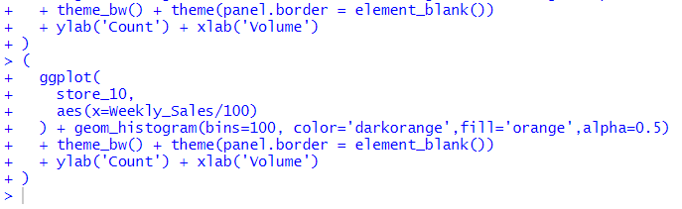

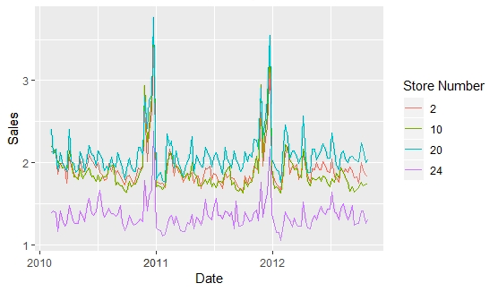
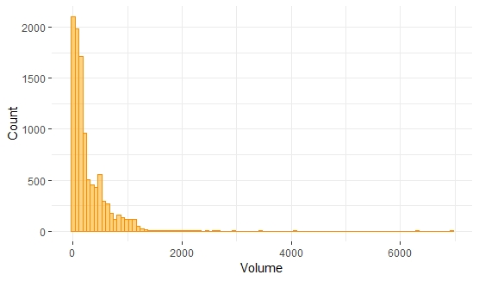


Slide 2





Data Visualization Specialist
Data Analyst
Data Scientist
Statistics
Regression and Classification
Predictive Modelling
Model Evaluation
Neural Networks
Tree Based Models
Data Storytelling
Business Analysis
R Tidyverse Libraries
Power BI / Tableau / Qlik
Statistics
Hypothesis Testing
Data Storytelling
GGplot2
Power BI / Tableau / Qlik
R Tidyverse Libraries
image: Flaticon.com

